Slide 1

OSNF
LECTURE
File System Management
Operating Systems Fundamentals
Diploma in CSF/IT
Year 1 (2021/22), Semester 2
5
Notes:
Left-hand Bar – Replace FSP by your module code and X by the lecture number.
Replace Lecture Title
Replace < Module Name >
Replace Year and Semester if necessary

Slide 2
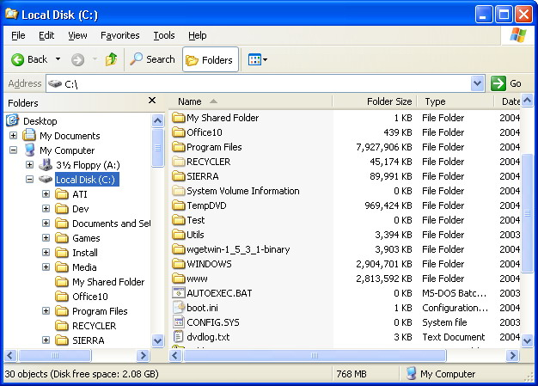

Topics
File system functions
Absolute & relative pathname
Internal and file fragmentation
Partitioning and formatting
Folders and file attributes
File types
Windows File System
File Allocation Table (FAT)
New Technology File System (NTFS)
Extended FAT (exFAT)
This Photo by Unknown Author is licensed under CC BY
This Photo by Unknown Author is licensed under CC BY-NC
This Photo by Unknown Author is licensed under CC BY-SA
This Photo by Unknown Author is licensed under CC BY-SA

Slide 3
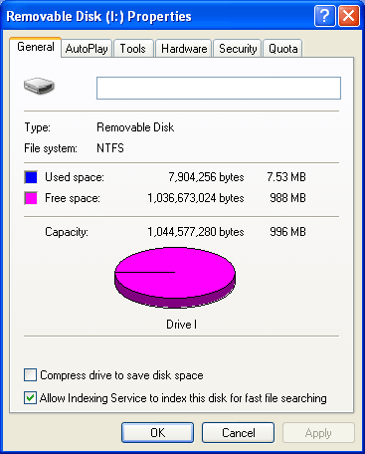
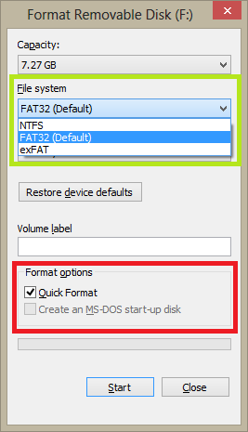
Understanding File System Functions
Operating system allows a user to store and access information on a computer.
These information is managed, stored and retrieved through a file system.
The file system allocates locations on disk for storage and it keeps a record of where specific information is kept.
Hence, the purpose of a file system is to create a structure for filing data.
E.g. of file systems are FAT32 and NTFS for Windows.

Slide 4
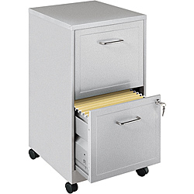



A File System Metaphor
Files
Subfolders
Folders
Disk drives
Computer

Slide 5
Designing a Folder Structure
Folders can be organized in a hierarchy that is similar to a tree structure.
For easy access control, similar information should be grouped.
Operating system files should be kept separate and protected so important files are not accidentally deleted by the users.
Each major folder has subfolders to keep grouped files or application software separate.

Slide 6
Sample Folder Structure for a Windows-based System
Root (\)
Windows
Users
Forms
Program Files
Public
Username
Public documents
Documents
Microsoft Office
Adobe
Contracts
Wills
Court
Tax

Slide 7
Absolute Pathname
Absolute pathname of the report.docx file starts with the root folder…
Root folder
\
Personal Group Family
readme.txt
Tasks
Projects
Events Photos
report.docx
FSP.java
Jan10.jpg
May10.jpg
Absolute pathname: C:\Group\Projects\report.docx
Drive
Root folder
Separators

Slide 8
Relative Pathname
Relative pathname of the report.doc file starts with the current working folder…
Traversing upward
Traversing downward
\
Personal Group Family
Current working
folder
readme.txt
Tasks
Projects
Events Photos
report.docx
FSP.java
Jan10.jpg
May10.jpg
Relative pathname: ..\Photos\May10.jpg
..\..\Group\Projects\report.docx
Go to parent
(1 level up)

Slide 9
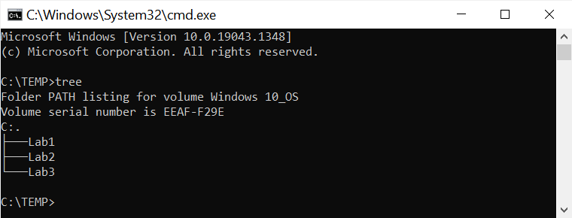
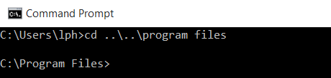
Activity 1
From command prompt, type the “tree” command and press enter.
Navigate 2 levels up into the program files folder:

Slide 10


Understanding File System Functions – cont.
A file is a set of data grouped in some logical manner, assigned a name, and stored on the disk.
As file is stored, the file system records where the file is located on disk so as to retrieve that file later.
The data contained in file can be text, images, music and sound, video, or web pages.
No matter what kind of data is stored in file system, it must be converted into digital format (a series of 1s and 0s) that computer understands.

Slide 11
Understanding File System Functions – cont.
In additional to the names of files and where to find them, the following are also stored:
Date & time the folder/file was created
Date & time the folder/file was last modified
Date & time the folder/file was last accessed
Folder/file size
Folder/file attributes, such as security information or when it was backed up
If information in folder/file is compressed or encrypted

Slide 12
Storage types
Your choice of storage device: HDD (Hard Disk Drive) or SSD (Solid-State Drive)
HDD is the traditional spinning hard drive that is the basic nonvolatile storage on a computer.
When a hard disk is delivered from manufacturer, it is low-level formatted.
A low-level format is a software process that marks the location of disk tracks and sectors.
An SSD does functionally everything a hard drive does, but data is instead stored on interconnected flash memory chips that retain the data even when there's no power.

Slide 13
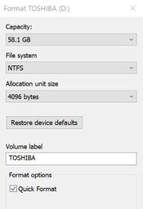
Storage Basics – cont.
Cluster:
Smallest allocation unit of a disk (e.g. 4096 bytes for NTFS).
Any read or write operation consumes space of at least 1 cluster.

Slide 14
Internal Fragmentation
What would be the implication of having a large cluster size of 32KB?
Imagine your files are mainly of small size, e.g. in the region of 10KB, this would means that 22KB (32-10KB) of the cluster is not used and wasted.
This is referred to as an Internal fragmentation.
Hence internal fragmentation is the wastage of disk space within the cluster due to the actual file size being smaller than the allocated space.
This also resulted in Slack space.
Slack space (also called file slack) is the space between the end of a file and the end of the disk cluster it is stored in.

Slide 15
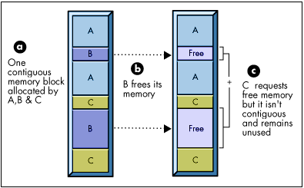
What is File Fragmentation?
Fragmentation occurs when a file is divided into pieces scattered around the disk.
When you use a disk frequently, creating, deleting, and modifying files. At some point, the operating system needs to store parts of a file in noncontiguous clusters
When a small file is deleted, it may leave a small set of contiguous clusters which is not sufficient to be filled by a new file which is bigger.

Slide 16
File Allocation using Clusters
File Allocation Table (FAT) located on the disk
Cluster No. : 1 2 3 4 … 97 98 99 100
Cluster Content :
3
4
98
99
EOF
EOF – End Of File
Directory Entry also located on the disk
Name
Pointer to 1st Cluster
Other Attributes
File1
2
RWX, date, etc
File 2
10023
RW, date, etc
…
…
…
File n
…
…

Slide 17
Fragmented and Contiguous Files
File Allocation Table (FAT)
Cluster No.: 1 2 3 4 … 97 98 99 100 101 102 103
Cluster Content :
3
4
98
99
EOF
101
102
103
EOF
Directory Entry
Name
Pointer to 1st Cluster
Other Attributes
File1
2
RWX, date, etc
File 2
100
RW, date, etc
…
…
File n
…
…
File 1
Which is a fragmented file?
Which is a contiguous file?
File 2

Slide 18
Consequence of Fragmentation
A fragmented file makes the OS search the disk for different groups of clusters scattered around the disk to find all of the file’s parts which slows down access time thus degrading system performance of disk operations.
Notes:
Not very applicable for SSD

Slide 19
Defragmentation
Defragmentation describes the process of consolidating fragmented files on your computer's hard disk.
It does this by physically reorganizing the contents of the disk to store the pieces of each file close together and contiguously.
After defragmentation, most of the files will be contiguous thus resulting in faster access of the file.
Disk Defragmenter is a system utility tool that rearranges files stored on a hard disk to occupy contiguous storage locations.
Notes:
Not very applicable for SSD.

Slide 20
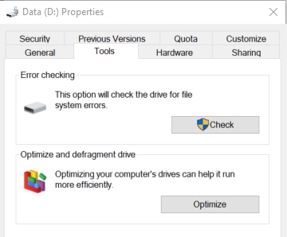
Defragmentation – cont.
To start disk defragmenter, Right-click on the disk volume that you want to defragment, and then click Properties.
On the Tools tab, click Optimize (Optimize and defragment drive).

Slide 21
Partitioning
Partitioning split a single physical disk drive into a number of partitions (or volumes) to which a drive letter can be assigned.
E.g. a SSD can be partitioned into C: drive and D: drive
Each partition must be formatted using a particular file system (e.g. FAT32, NTFS).
To view the partitions on Windows 10:
From Windows Explorer, right click on This PC and select Manage, click on Disk Management.
Video: http://www.youtube.com/watch?v=AeUM4kR67XQ

Slide 22
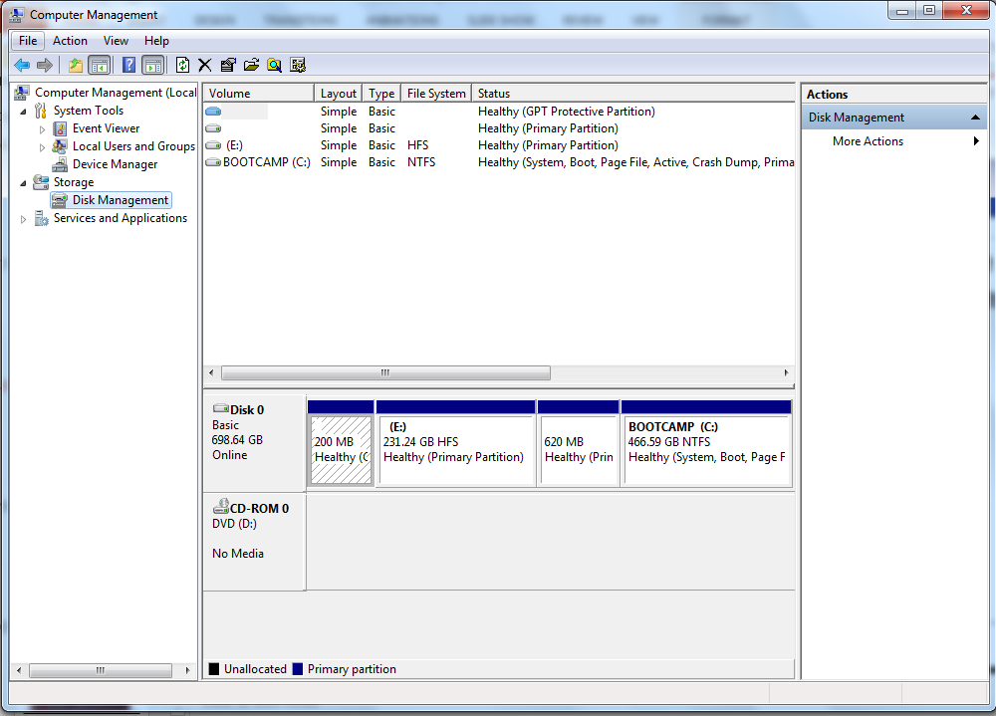
A Disk with Multiple Partitions

Slide 23
Formatting
Prepares the chosen partition on the disk drive to be used by an operating system by deleting all of the data and setting up a file system
The boot block is placed in the first sector on the disk, which also contains the root folder.
The root folder is where system stores file information, such as name, start cluster, file size, file modification date & time, and file attributes (hidden, read-only, archive etc.)

Slide 24
The “format” Command
Warning: Do not type the format command to avoid loss of data!
E.g. format /fs:FAT32
Switch | Function
/v:label | Specifies the volume label
/q | Uses a quick format technique that does not check disk for damaged clusters
/f:size | Specifies the size to format
/fs:filesystem | Specifies the file system to format
/t:tracks | Designates the number of tracks on a side
/n:sectors | Designates how many sectors on a track
/p:passes | Writes zeros in all sectors for the number of times specified in the passes parameter. This is not valid with /q switch.

Slide 25
Folders & File Attributes
File manager tracks each user’s authorization to access files using file attributes, which are codes signifying the ability of every system user to manipulate the file.
There are several standard actions that users can be granted, depending on the operating system.

Slide 26
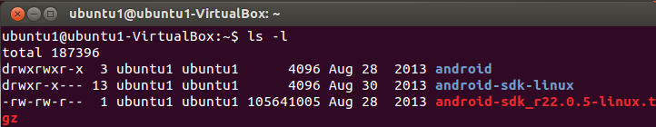
Folders & File Attributes (UNIX/Linux)
Attributes assigned by Linux, Mac OS X, and other UNIX systems :
d Directory (a file is indicated with a dash)
r Read access allows a user to view file only
w Write access allows a user to modify file content
x Execute access allows a user to run an executable file.
Folder listing in Ubuntu Linux showing attributes on the left:

Slide 27
Folders & File Attributes (UNIX/Linux) – cont.
Here is how to read the code:
r w x for file’s Owner indicates that the owner is allowed to read-write-execute the file
r - x for Group indicates that others in the user’s group are only allowed to read and execute the file
r - x for World indicates that anyone else is only allowed to read and execute the file
d r w x r – x r – x
Indicate folder or “-” for file
Owner
Group
World

Slide 28
Folders & File Attributes (Windows)
Windows system work in a similar way:
D Directory (folder)
R Read-only file access
S System file that can be executed
H Hidden file
A Archived file

Slide 29
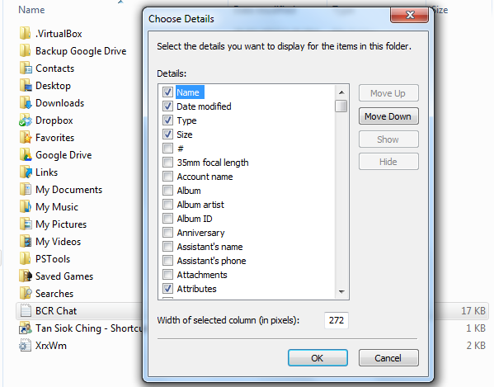
Activity 2
On your Windows machine, start Windows Explorer.
Right-click the header bar (next to Name), choose More and select Attributes.
You should see some of the attributes assigned to each file.

Slide 30
File Types
For every file, operating system needs to know how to open, execute, and close it gracefully.
Windows OS use file extension to indicate the application associate with it, but Mac, Linux, and other OSs do not require an extension but information stored within the file to do the same thing.
Common file types and extensions:
File Extension | File Type
DOCX | Document
EXE | Executable file
JPEG | Graphics file
TXT | Text file

Slide 31
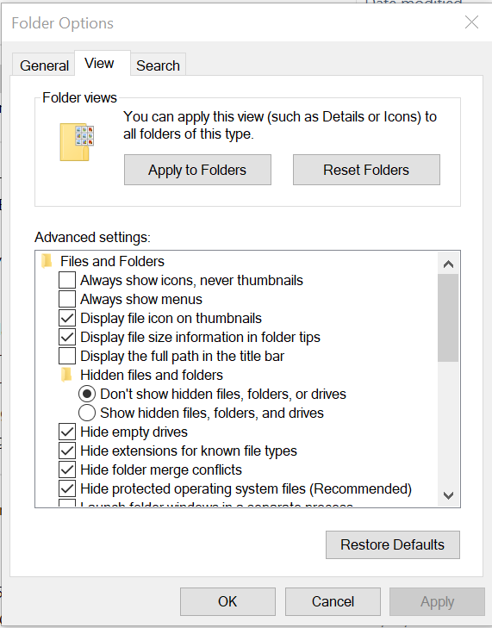
Activity 3
By default on Windows machine, extensions for known files are hidden. To see the extensions of files:
From Windows Explorer, select View > Options > Change folder and search options
Select View tab, then uncheck Hide extensions for known file types

Slide 32
Windows File System
(FAT, NTFS and exFAT)

Slide 33

What is a Boot Sector?
Boot sector on a disk drive includes information about how to start the boot process in order to load an OS.
Types of boot sector:
Master boot record (MBR) - the first sector of a partitioned disk drive; holds the information on how the logical partitions, containing file systems, are organized on the disk
Volume boot record (VBR) – the first sector in a partition.
Notes:
https://en.wikipedia.org/wiki/Master_boot_record
The MBR holds the information on how the logical partitions, containing file systems, are organized on the disk.
The MBR also contains executable code to function as a loader for the installed operating system—
usually by passing control over to the loader's second stage, or in conjunction with each partition's volume boot record (VBR).
This MBR code is usually referred to as a boot loader.
https://en.wikipedia.org/wiki/Volume_boot_record
On non-partitioned storage devices, it is the first sector of the device.
On partitioned devices, it is the first sector of an individual partition on the device,
with the first sector of the entire device being a Master Boot Record (MBR) containing the partition table.

Slide 34
File Allocation Table (FAT) File System
FAT file system is used in earlier Microsoft operating systems.
There are different versions of the FAT file system. FAT entries can be 12, 16, or 32 bits long corresponding to FAT 12, FAT 16, or FAT 32 file system respectively.
The FAT file system consists of three main components:
Volume Boot Record (VBR)
Directory Entries
File Allocation Table

Slide 35
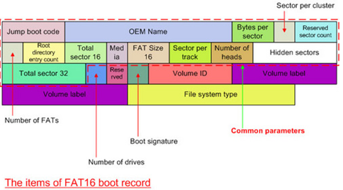
Volume Boot Record (VBR)
VBR (also known as boot sector or volume boot) is the first sector of a partition. It
contains code to initiate the boot process or loading the OS
defines the file system type,
holds the parameter information such as
bytes per sector,
sector per cluster,
etc.

Slide 36
Directory Entry
Every file and folder is referenced in a separate 32-byte entry called a Directory Entry.
Each directory entry contains information such as:
Name of file/folder
Time and Date metadata
Location (starting cluster)
Size of file
Metadata summarizes basic information about the file. E.g.
MAC (Modify/Access/Create) time stamp
Author

Slide 37
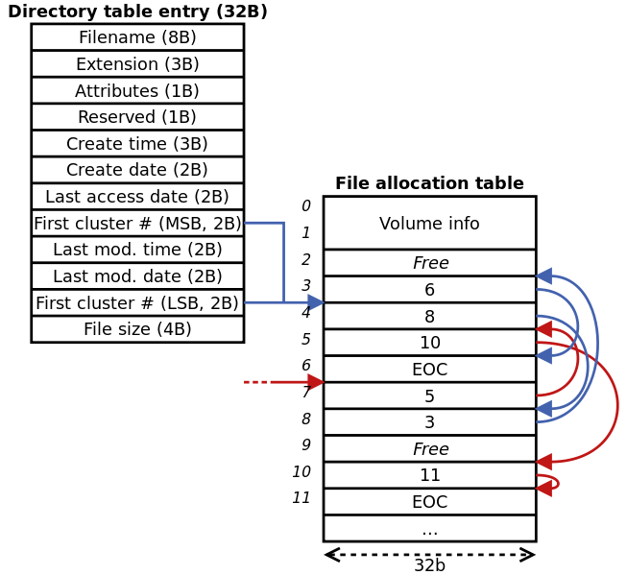
Directory Entry – cont.
Notes:
EOC – End of Content (aka EOF – End of File)

Slide 38
File Allocation Table (FAT)
The FAT can be thought of as a map of all the clusters on the disk drive. The FAT contains an entry for each cluster.
The FAT tracks which clusters are allocated and unallocated, tracking those allocated clusters for each file.
Many times a document may surpass one cluster and need to be stored in multiple noncontiguous clusters.
As covered in previous topic, files are fragmented on the disk.
It is FAT that links these clusters.

Slide 39
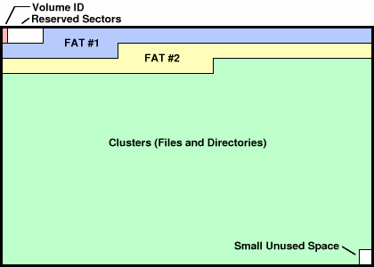
File Allocation Table (FAT) – cont.
In FAT file system, the FAT is by default identified as FAT1. The FAT maintains a spare copy of itself as FAT2.
Structure of a FAT Partition:
VBR

Slide 40
Class Activity 4
Thinking Question
“Why are there TWO copies of File Allocation Tables (FAT)?”
Notes:
Complete Week 1 Activity 1

Slide 41
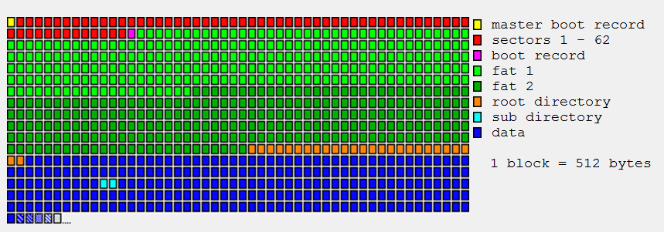
File Allocation Table of FAT16
Structure of a partitioned disk drive
Beginning of 1st partition
(MBR)
(VBR)

Slide 42
File Allocation Table (FAT) – cont.
Key values within FAT:
Description | Value
Unallocated | Represented by 0
Allocated | Value will be represented by the next cluster used by the file
Last Allocated | The last cluster used by the file (End Of File). FAT 12 – value >= FF8 (12-bit) FAT 16 – value >= FFF8 (16-bit) FAT 32 – value >= FFFFFFF8 (32-bit)
Bad Cluster | FAT 12 – FF7 FAT 16 – FFF7 FAT 32 – FFFFFFF7

Slide 43
How does the FAT work?
A file is called for by file name and path.
The storage path leads to the location of the parent directory.
It is here that the directory entry for that file is located.
The operating system (OS) looks in this parent directory and reads the directory entry.
The directory entry provides the starting cluster (starting physical location on the disk) and size of the file.
The OS then goes to the starting cluster and begins to read the data.

Slide 44
How does the FAT work? – cont.
It only reads the data within the cluster up to the size of the file.
If the file size surpasses one cluster, then the FAT is necessary in order to link these clusters together.

Slide 45
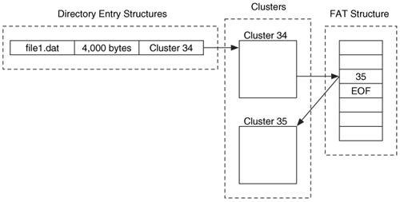
How does the FAT work? – cont.

Slide 46
Class Activity 5
A computer is configured with cluster size of 4 sectors. A sector is 512 bytes. If a file of 5,000 bytes is written onto the disk,
i) Calculate the slack space created in bytes,
ii) With an aid of a well-labeled diagram, show how the file is stored in these clusters and the location of slack space.
Note: Assume the file is stored in contiguous clusters.
512 * 4 = 2048 bytes
A file = 5000 bytes,
therefore 2048 bytes will need 3 clusters
(2048 * 3) – 5000 = 6144 – 5000 = 1144 bytes
Slack space = 1144 bytes
Notes:
Complete Week 1 Activity 1

Slide 47
Example: Directory Entries and File Allocation Table
Assume cluster size is 32 KB (64 sectors)
Recall that sector size is 512 bytes.
Let’s look at Directory entry for hello2.txt:
Since file size = 74 KB, it takes 3 clusters to store hello2.txt.
File Name | File Size | 1st cluster
hello2.txt | 74KB | 2
file A.docx | 10KB | 11
….

Slide 48
Example: Directory Entries and File Allocation Table – cont.
A FAT 16 file system uses 16 bits to represent each cluster, as follows:
For simplicity, we will convert each hexadecimal to decimal for illustration:
FFF8 | FFFF | 002A | FFFF | FFFF | FFFF | FFFF | FFFF | …
0013 | 0014 | 0015 | 0016 | 0017 | 0018 | 0019 | 001A | …
0000 | 0000 | 0000 | 0000 | 0000 | FFFF | 002B | FFF8 | …
65528 | 65535 | 42 | 65535 | 65535 | 65535 | 65535 | 65535 | …
19 | 20 | 21 | 22 | 23 | 24 | 25 | 26 | …
0 | 0 | 0 | 0 | 0 | 65535 | 43 | 65528 | …

Slide 49
Example: Directory Entries and File Allocation Table – cont.
0
1
2
3
4
5
6
7
65528 | 65535 | 42 | 65535 | 65535 | 65535 | 65535 | 65535 | …
13 | 14 | 15 | 16 | 17 | 18 | 19 | 20 | …
0 | 0 | 0 | 0 | 0 | 65535 | 43 | 65535 | …
0 | 0 | 0 | 0 | 0 | 0 | 0 | 0 | …
18
19
20
21
22
23
24
25
36
37
38
39
40
41
42
43
58
59
60
61
62
63
64
65
Cluster 0 and 1 are reserved.
From Directory entry, the 1st cluster for hello2.txt is cluster 2.
Tracing from cluster 2 shows that the next cluster is 42. And from cluster 42, the next cluster is 43.
Any value greater than or equal to FFF8 (decimal 65528) is interpreted as End Of File (EOF).
At cluster 43, it indicates that EOF has been reached.
Hence cluster numbers for hello2.txt is 2 → 42 → 43.

Slide 50
Example: Directory Entries and File Allocation Table – cont.
18
19
20
21
22
23
24
25
0x13 | 0x14 | 0x15 | 0x41 | 0x42 | 0x18 | 0x00 | 0x1A | …
0x00 | 0x44 | 0x43 | 0x00 | 0x40 | 0x00 | 0x10 | 0x00 | …
0x00 | 0x31 | 0x00 | 0x00 | 0x30 | 0x00 | 0000 | 0x00 | …
36
37
38
39
40
41
42
43
58
59
60
61
62
63
64
65
Look inside cluster contents to determine file’s data.
For simplicity, assuming each cluster is 1 byte. And Hello1.txt clusters numbers are 21→22→38
Contents of Hello1.txt are:-
Cluster 21 – 0x41 ‘A’
Cluster 22 – 0x42 ‘B’
Cluster 38 – 0x43 ‘C’
Refer to 7-bit Ascii character set in Week 4 learning material in Mel, Hello1.txt contents are ABC.

Slide 51

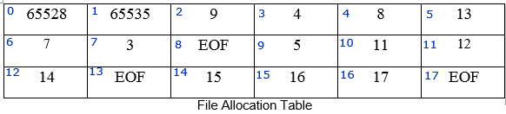
Class Activity 6
A computer is formatted with FAT16 file system. The Directory entry and File Allocation Table are as shown below. List the cluster numbers in correct sequence to retrieve OSF_Tutorial1.docx from the disk drive. Assume the cluster size is 2,048 bytes.
Notes:
Complete Week 1 Activity 1

Slide 52
Class Activity 6 (con’t)
Notes:
Complete Week 1 Activity 1

Slide 53
New Technology File System (NTFS)
The NTFS started with Windows NT in 1993. Windows XP, 2000, Server 2003, 2008, and Windows 7/8/10 use NTFS.
In NTFS, all data are allocated to files, including the file system itself.
NTFS contains the following components:
Partition Boot Record (PBR) – similar to VBR in FAT
Master File Table (MFT) – similar to directory entry in FAT
$Bitmap – similar to FAT
Notes:
The $BitMap is a special file within the NTFS file system. This file keeps track of all of the used and unused clusters on an NTFS volume.
When a file takes up space on the NTFS volume the location is uses is marked out in the $BitMap.
The method of keeping track of cluster allocation is relevatively simple

Slide 54
Partition Boot Record (PBR) (Optional)
It comprised of 16 sectors, as opposed to 1 sector with FAT.
However, only 8 out of 16 sectors are used.

Slide 55
Master File Table (MFT) (Optional)
MFT is the heart of the NTFS file system.
Every object contained on an NTFS volume has an entry in the Master File Table ($MFT).
When a file is created in NTFS, a record for that file is added to the MFT.
MFT entry tracks the object (file/folder) name, size, date/time, the starting extent (allocation block/cluster) and any fragmentation of that object.
MFT is scattered throughout the disk structure. It is not contained to certain specified sectors as are FAT directory entries.
Each entry in MFT has fixed length of 1,024 bytes.

Slide 56
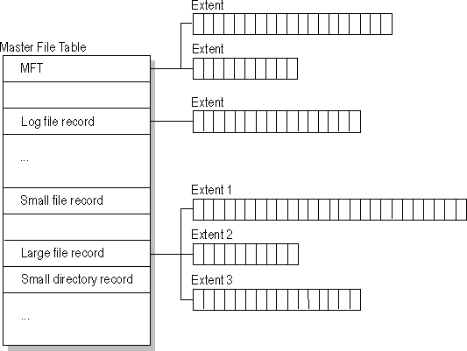
Master File Table (MFT) – cont. (Optional)
Small files (typically 1500 bytes or smaller) are stored within MFT record.
Larger files are stored in clusters outside MFT.

Slide 57
$Bitmap (Optional)
$Bitmap is a file that represents cluster allocation within a partition.
It identifies if a cluster is allocated or unallocated.
Each bit within $Bitmap represents a cluster.
‘0’ – unallocated/available
‘1’ – allocated/unavailable
$Bitmap does not identify starting locations of files, length etc. It simply tells if the cluster is allocated or not.

Slide 58
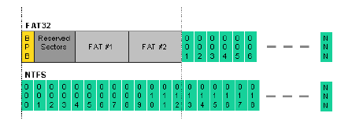
FAT vs NTFS (Optional)

Slide 59
Class Activity 7 (Optional)
Thinking Question
“In NTFS system, where is MFT located? What information can be found in Master File Table (MFT)?”
In a group of 3, discuss and share your answer with the class. Your lecturer will moderate the class discussion.
Notes:
Complete Week 1 Activity 1

Slide 60
Extended FAT (exFAT)
Microsoft file system optimized for flash memory such as USB flash drives and SD cards
Can be used where the NTFS file system is not a feasible solution (due to data structure overhead), yet the file size limit of the standard FAT32 file system is unacceptable.
For flash drives and disk drives to be able to be read and written to in both Windows and Mac machines, it must be formatted to ExFAT or FAT32 file format.
File size limit for FAT32 is 4GB, hence for files bigger than 4GB, it can be stored either in NTFS or exFAT

Slide 61
Class Activity 8
Thinking Question
Refer to https://www.ilicomm.com/whats-the-difference-between-fat32-exfat-and-ntfs , summarise the three types of file system.
Notes:
Complete Week 1 Activity 1

Slide 62
Class Activity 8: FAT vs NTFS vs exFAT– cont.
File Allocation Table (FAT) | New Technology File System (NTFS) | exFAT

Slide 63
Summary
File system allocates clusters on disk for storage and it keeps a record of where specific information is kept.
internal fragmentation is the wastage of disk space within the cluster due to the actual file size being smaller than the allocated space.
Slack space (also called file slack) is the space between the end of a file and the end of the disk cluster it is stored in.
File Fragmentation is the scattering of parts of the same file over different areas of the disk.

Slide 64
Summary – cont.
Partitioning is the process of blocking a group of tracks and sectors to be used by a particular file system.
File manager tracks each user’s authorization to access files using file attributes.

Slide 65
Summary – cont.
The earlier Windows file systems are FAT 12/16/32, used before Windows NT and still in use by flash drives and some mobile phones.
The key components of FAT file system are VBR, Directory entry and FAT.
File size limit for FAT32 is 4GB, hence for files bigger than 4GB, it can be stored either in NTFS or exFAT

Slide 66

Next will be MEL Quiz
Log into MEL
Individual Assessment
Close Book
There will be in-class quiz for every week of lessons.
Total marks for accumulated quiz is 10% of the total assessment.
Do well in your quiz!

